Slide 1

Tourism Authority in New York City
investigation in MTA data
BY :AMAL ALSHAHRANI

Slide 2
Backstory :
We are tourism Authority in New York City .One of the tour guides has encountered a noticeable traffic at some Subway stations. The guide seeks to rescue the authority from the money loss and bad reputation .So he has investigated MTA data (Metropolitan Transit Authority) about most traffic stations based on number of entries
in order to help them to determine which stations have most traffic than others and facilitate the transportation via subway stations

Slide 3
II. Setup(collecting data):
.
MTA :
A series of data files containing numbers of cumulative entries and exits by stations, turnstile, along with their dates and time.
Dataset :
We used historical data from MTA’s turnstiles, deciding to focus on data from January and April 2017.
The months of January to April the traffic based on the number in NY
◉ 2474417 rows ◉ 11 columns

Slide 4
TOOLS :
SQLite
Python
Jupyter
notebook
SQLAlchemy
Libraries including (NumPy Pandas Matplotlib Seabor0n

Slide 5
III. Preparing the data
DATA CLEANING :
Check Duplicates
Date Time column
Add new columns
Found duplicated rows
Fix columns
Check nulls
o no null values
Total EXITS entries

Slide 6
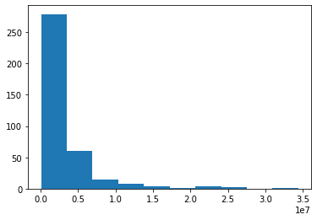
Histogram shows the number of daily entries at stations

Slide 7
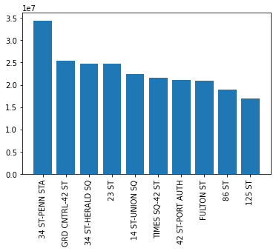
The plot illustrates the rate of daily entries per each station

Slide 8
New Insights :
– exploring and analyzing data that will be provided to better strategic decisions in the MTA organization.
- the organization become more aware and able to take proactive processes to mange the traffic .

Slide 9
Thanks For YOUR attention :
AMAL ALSHAHRANI

